Slide 1



COASTAL EROSION PREDICTION PLATFORM
24GEP31- MINI PROJECT REVIEW II
PROJECT MEMBER : ATITYA RAM S – 24CSL362
SRI HARINII K – 24CSR297
RAM ANANDHU S - 24EER091
PRATHEESH RAHUL M – 24CHR035
            PROJECT MENTOR :
            Dr. N. SASIPRIYAA, Associate Prof./CSE
CO-MENTOR:
Ms.A.TAMILARASI, Assistant Prof./Chem

Slide 2
PROBLEM DESCRIPTION
Create a satellite-image analytics system to monitor and predict coastal erosion patterns.
The solution should integrate spatial datasets such as maps, satellite imagery, terrain, rainfall, infrastructure, and field records to generate meaningful decision layers.
The outcome may include risk maps, priority zones, dashboards, and validation using historical records or expert-labelled ground truth.
2

Slide 3
LITERATURE REVIEW
S.NO | TITLE | AUTHOR NAME | JOURNAL & YEAR | DATASET TYPE | METHODOLOGY | ACCURACY / PERFORMANCE | LIMITATIONS
1 | Preparing coastal erosion vulnerability index applying deep learning techniques in Odisha state of India (Main Foundation) | Badal Mohanty, Raju Sarkar, Sunil Saha | International Journal of Disaster Risk Reduction, 2023 | 32 environmental & socio-economic factors; 2,500 locations | SVM, Random Forest, SNN, DNN, CNN; sensitivity & factor-importance analysis | RF: 0.96, CNN: 0.93, DNN: 0.91, SVM: 0.88, SNN: 0.88 | Focuses on Odisha; mainly estimates vulnerability, not detailed future shoreline movement.
2 | Predicting Shoreline Changes Along the California Coast Using Deep Learning Applied to Satellite Observations (Prediction Reference) | Susheel Adusumilli, Nicholas Cirrito, Laura Engeman, Julia W. Fiedler, R. T. Guza, Athina M. Z. Lange, Mark A. Merrifield, William O'Reilly, Adam P. Young | Journal of Geophysical Research: Machine Learning and Computation, 2024 | 23 years of satellite-derived waterline observations, nearshore wave hindcasts, tide data, and in-situ beach surveys | Deep Neural Network (DNN) | 64% predicted within 10 m; fair skill for 50% of transects. | Limited predictors; study focused on California coast .

Slide 4
3 | Unraveling Sundarbans’ erosion: how machine learning maps climate change impacts (Latest Indian Reference) | Jyotirmoy Biswas, Sabyasachi Maiti | npj Climate Action, 2026 | Landsat 5 & 8 satellite imagery, 1988–2023; 21,918 transects | DSAS, LRR, Random Forest, Gradient Boosting; NDWI/MNDWI/AWEI/WI₂₀₁₅/MBWI + Otsu for shoreline extraction . | For overall erosion, RF validation R² ≈ 0.90 and GB ≈ 0.84; erosion subset RF ≈ 0.91, GB ≈ 0.87 | Some validation/testing differences and overfitting; accretion is highly nonlinear and had no single optimal LR² threshold.

Slide 5
RESEARCH GAP
Limited data integration: Existing studies often use satellite images alone instead of combining satellite, terrain, rainfall, infrastructure, and field data.
Less focus on prediction: Many methods mainly detect past coastal changes but do not predict future erosion-prone areas.
Limited decision support: Existing systems may not clearly provide risk maps and priority zones for coastal management.

Slide 6
OBJECTIVES
Collect and integrate satellite images, maps, terrain, rainfall, infrastructure, and field data.
Analyze coastal changes and identify areas affected by erosion.
Predict future erosion-prone areas using data analysis and machine learning.
Generate risk maps and priority zones to support coastal management and decision-making.
3

Slide 7
PROPOSED METHODOLOGY
Data Collection & Preprocessing – Collect satellite images, maps, terrain, rainfall, infrastructure, and field data, then clean and prepare them for analysis.
Shoreline Detection – Extract the coastline from satellite images and identify changes over different years.
Feature Analysis – Analyze factors such as rainfall, elevation, land use, and infrastructure that affect erosion.
Erosion Analysis – Identify areas with high, medium, and low erosion levels.
Prediction – Use Machine Learning to predict future erosion-prone areas.
Risk Mapping – Generate coastal erosion risk maps and priority zones using GIS.
Validation – Compare predictions with historical records and field data.
4

Slide 8
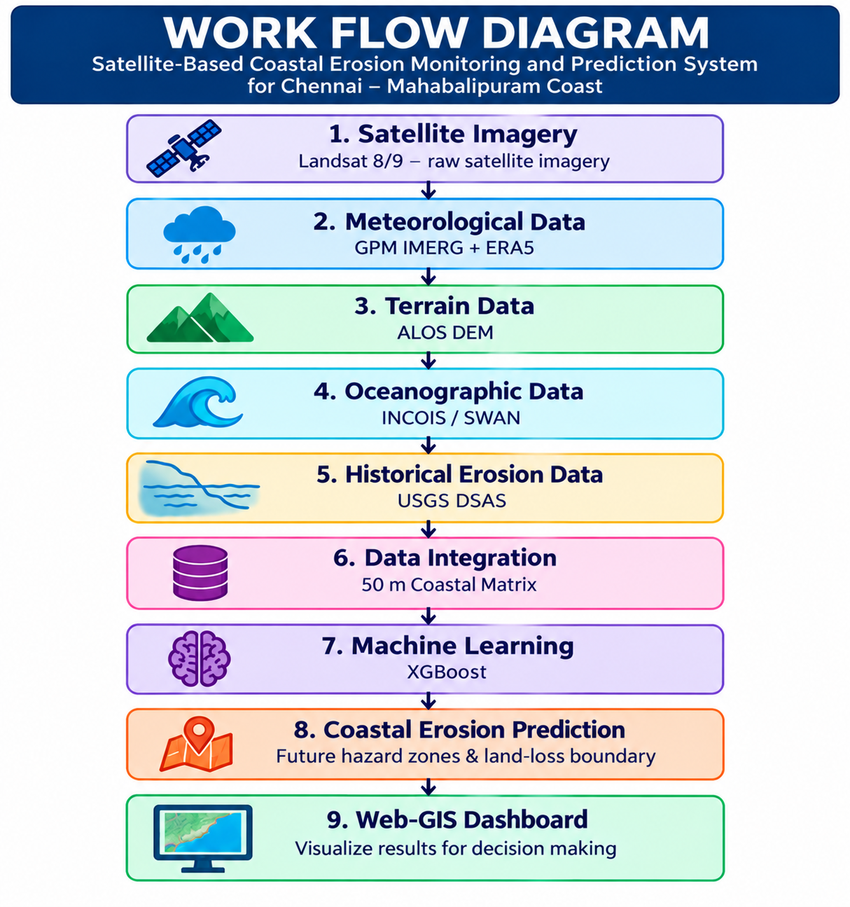
WORKFLOW

Slide 9
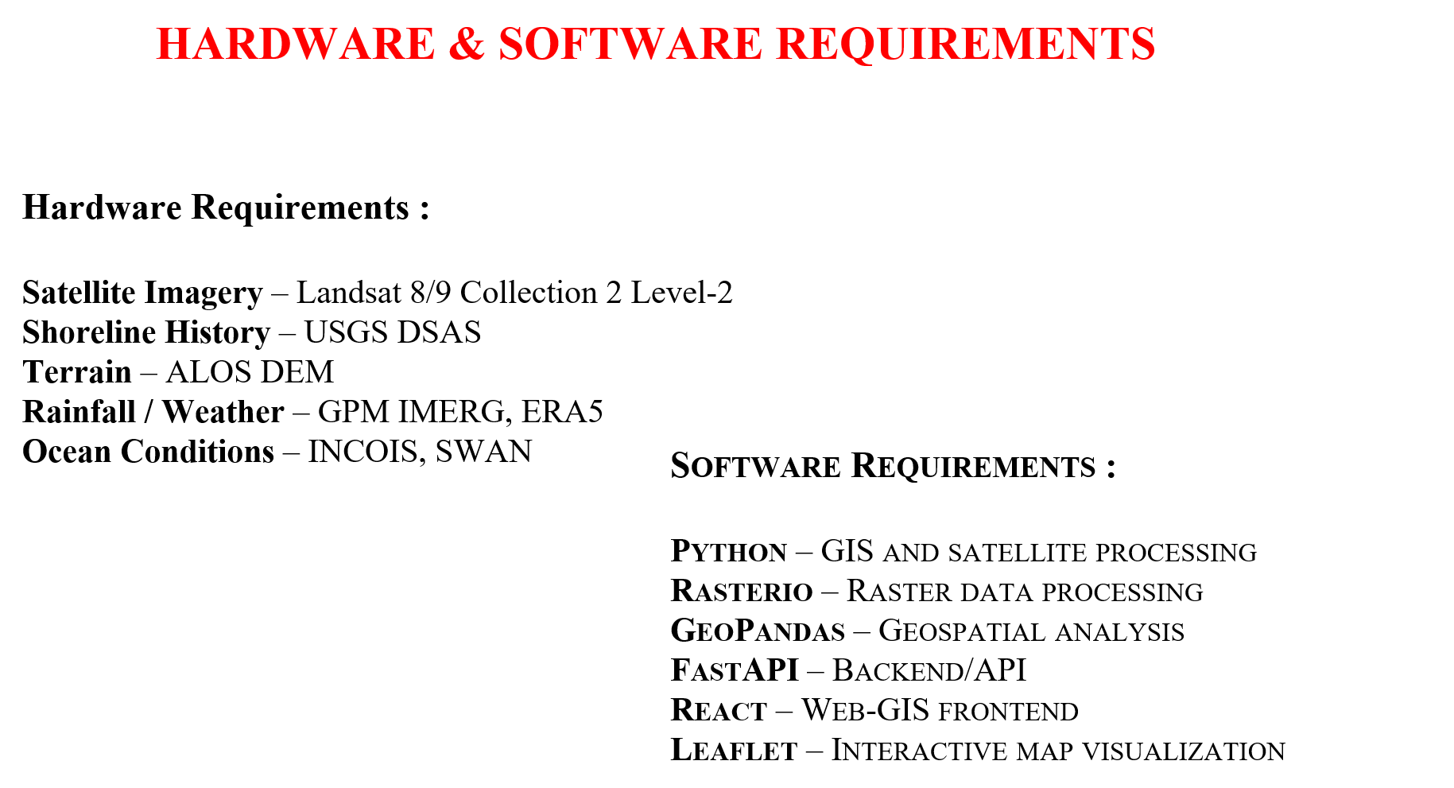

Slide 10
SOFTWARE TOOLS
Python – Programming Language
Jupyter Notebook – Data Analysis
TensorFlow/Keras – LSTM Model
Gymnasium – DQN Development
Visual Studio Code – Development Environment
Pandas, NumPy & Scikit-learn – Data Processing Dashboard – Streamlit
Dataset Source - ACN Data API
2

Slide 11
MODULE DESCRIPTION
1. Satellite Imagery Module
Collects the latest and historical satellite imagery for the Chennai–Mahabalipuram coastal region and performs satellite-based coastal analysis.
2. Shoreline History Module
Extracts and stores shorelines from different dates to measure historical shoreline movement and identify erosion, accretion and stable areas.
3. Terrain Module
Provides elevation, slope and coastal terrain information to support analysis of shoreline changes.
4. Rainfall / Weather Module
Provides rainfall and atmospheric/weather information to analyze environmental conditions associated with coastal changes.
5. Ocean Conditions Module
Provides wave, tide and other oceanographic information to support analysis of coastal erosion.
6. AI Master Prediction Module
Combines the outputs of the above modules and uses ConvLSTM + XGBoost to estimate future shoreline change and potential erosion zones.

Slide 12
SUSTAINABLE DEVELOPMENT GOALS(SDG)
SDG 13 – Climate Action:
Helps monitor and predict coastal changes caused by climate-related impacts.
SDG 14 – Life Below Water:
Supports protection and sustainable management of coastal and marine ecosystems.
5

Slide 13
REFERENCES
[1] Adusumilli, S., Cirrito, N., Engeman, L., Fiedler, J. W., Guza, R. T., Lange, A. M. Z., Merrifield, M. A., O'Reilly, W., & Young, A. P., "Predicting Shoreline Changes Along the California Coast Using Deep Learning Applied to Satellite Observations," Journal of Geophysical Research: Machine Learning and Computation, vol. 1, no. 3, 2024. DOI: 10.1029/2024JH000172.
[2] Biswas, J., & Maiti, S., "Unraveling Sundarbans’ erosion: how machine learning maps climate change impacts," npj Climate Action, vol. 5, Article 33, 2026. DOI: 10.1038/s44168-026-00336-8.
[3] Mohanty, B., Sarkar, R., & Saha, S., "Preparing coastal erosion vulnerability index applying deep learning techniques in Odisha state of India," International Journal of Disaster Risk Reduction, 2023. DOI: 10.1016/j.ijdrr.2023.103770.
5

